Slide 1


Big Data
Apache Hadoop
Hadoop is an open source software framework originally incepted in 2006. The main purpose of Hadoop is to handle a large number of datasets. It is built with two main segments.
Hadoop Distributed File System (HDFS) and
MapReduce. HDFS is the storage constituent of Hadoop.

Slide 2
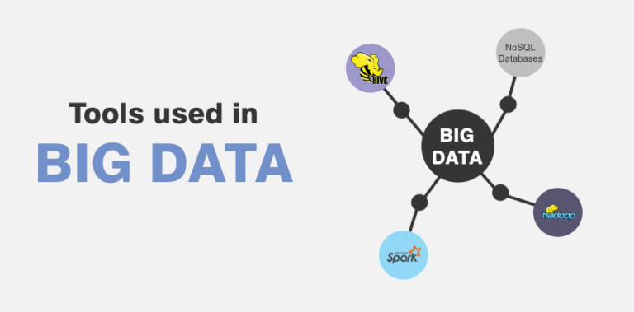
Big Data

Slide 3
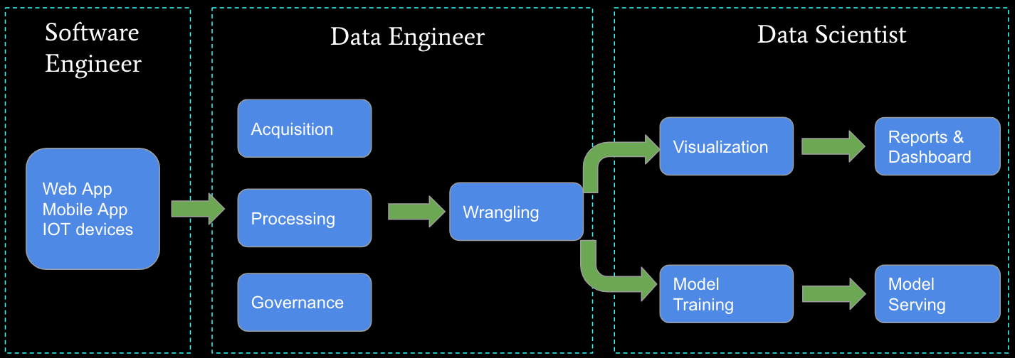
Software Eng, Data Eng and Data Scientist

Slide 4
Big Data
Apache Spark
Spark is commonly used as an option to Hadoop’s MapReduce as it is capable of analyzing data up to 100 times faster for certain applications. Some of the common use cases of Apache Spark include streaming data, machine learning and interactive analysis.

Slide 5
Big Data
Apache Hive
Apache Hive is a SQL-on-Hadoop data processing engine. Apache Hive excels at batch processing of ETL jobs and SQL queries. Hive employs a query language called HiveQL.

Slide 6
Big Data
NoSQL Databases
NoSQL databases demand these days because of the flexibility they offer in addition to SQL databases. These are not bound by traditional schema models allowing them to collect unstructured datasets. E.g. MongoDB, Cassandra, and HBase

Slide 7
Big Data
Roles

Slide 8
Data Engineer
Data Engineer
A data engineer is a professional who prepares and manages big data that is then analyzed by data analysts and scientists. They are responsible for designing, building, integrating, and maintaining data from several sources.

Slide 9
Data Analyst
Data Analyst
A data analyst gathers, organizes and interprets statistical data using data analysis tools to come up with meaningful results. The client then uses these interpretations to make important business decisions.
Data analysts are usually generalists, which means that they can fit in different teams or roles to help make data-driven decisions

Slide 10
Data Scientist
Data Scientist
Data scientist analyze and interpret raw data into business solutions using machine learning and algorithms.
A data scientist possess advanced knowledge of algorithms and statistics expertise. Additionally, they know how to build, train, and use machine learning and deep learning models for perform predictive analytics

Slide 11
Data Engineering
Data Engineers
A data engineer is a professional who prepares and manages big data that is then analyzed by data analysts and scientists. They are responsible for designing, building, integrating, and maintaining data from several sources.

Slide 12
Source Control
Git
Why source control
Industry popular
Git
TFS
Why data scientists should know source control
Git and GitHub

